Slide 1

Menon Bearings Limited
Investor Presentation – April 2023

Slide 2
Safe Harbour
This presentation and the accompanying slides (the “Presentation”), which have been prepared by Menon Bearings Limited (the “Company”), have been prepared solely for information purposes and do not constitute any offer, recommendation or invitation to purchase or subscribe for any securities, and shall not form the basis or be relied on in connection with any contract or binding commitment whatsoever. No offering of securities of the Company will be made except by means of a statutory offering document containing detailed information about the Company.
This Presentation has been prepared by the Company based on information and data which the Company considers reliable, but the Company makes no representation or warranty, express or implied, whatsoever, and no reliance shall be placed on, the truth, accuracy, completeness, fairness and reasonableness of the contents of this Presentation. This Presentation may not be all inclusive and may not contain all of the information that you may consider material. Any liability in respect of the contents of, or any omission from, this Presentation is expressly excluded.
Certain matters discussed in this Presentation may contain statements regarding the Company’s market opportunity and business prospects that are individually and collectively forward-looking statements. Such forward-looking statements are not guarantees of future performance and are subject to known and unknown risks, uncertainties and assumptions that are difficult to predict. These risks and uncertainties include, but are not limited to, the performance of the Indian economy and of the economies of various international markets, the performance of the industry in India and world-wide, competition, the company’s ability to successfully implement its strategy, the Company’s future levels of growth and expansion, technological implementation, changes and advancements, changes in revenue, income or cash flows, the Company’s market preferences and its exposure to market risks, as well as other risks. The Company’s actual results, levels of activity, performance or achievements could differ materially and adversely from results expressed in or implied by this Presentation. The Company assumes no obligation to update any forward-looking information contained in this Presentation. Any forward-looking statements and projections made by third parties included in this Presentation are not adopted by the Company and the Company is not responsible for such third party statements and projections.

Slide 3
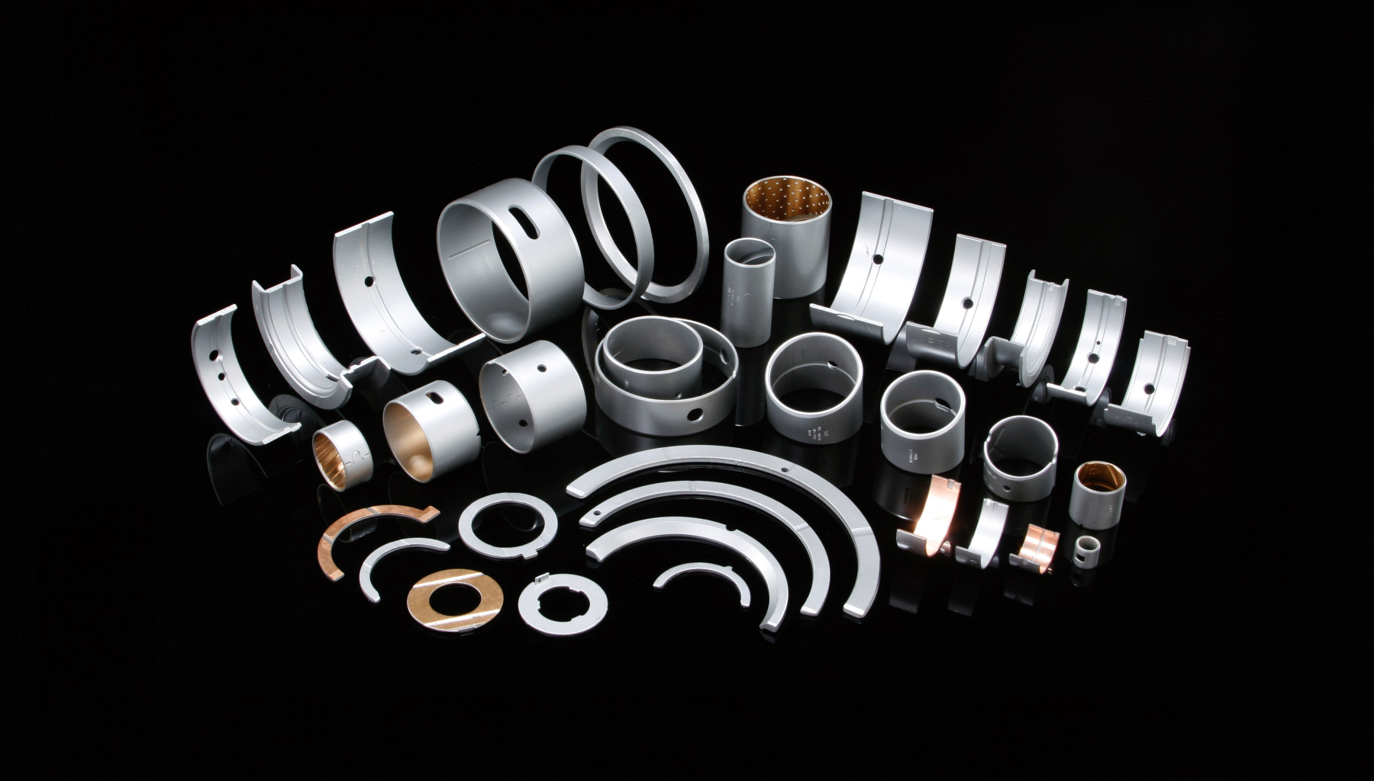

Financial & Operational Performance
Q4 & FY23

Slide 4
Update on Capex in Product Diversification – Brakes
Diversification of product portfolio by starting manufacturing of new production line in auto component segment i.e., eco-antifriction (asbestos free) materials to begin with products like brake lining, brake shoes etc.
Key Highlights of the Investments
Investment Rationale
Name of the product: Brake Lining, Brake Shoes
Industry: Auto Components
Product will be initially catering to the Domestic Market
Customers: All OEM’s into HCV / LCV / Heavy Duty Vehicles & Aftermarket & trailer manufacturers
The project will be funded through a mix of internal accruals & debt
The installed capacity is 15 lakh units/annum for Brake Lines and 2.4 lakh units/annum for Brake Shoes
Synergy with the existing manufacturing with Low Gestation period
Involvement of High-End Technology
Enjoys very good brand equity, having established robust Pan-India Network of 350+ Dealers and Distributors in place
Huge Potential: Brake lining are required to be changed after 40,000 kms i.e., 4 times a year for HCV and 6 to 8 times in a year for vehicles used in mining operations
Will cater to OEM's, Aftermarket, STU's, Railway and having presence in aftermarket across the globe, eventually we envisage to be one of the leading exporter of these products
Commercial production commenced in Q1 FY24, we will share updates in the coming quarters.

Slide 5
Key Financial Highlights – Q4 & FY23
Revenue (Rs. in Crs)
EBIDTA (Rs. in Crs)
PAT (Rs. in Crs)
+11%
+26%
+33%
+4%
+25%
+35%
Q4FY22
Q4FY23
FY22
FY23
Q4FY22
Q4FY23
FY22
FY23
Q4FY22
Q4FY23
FY22
FY23
Gross Profit Margin (%)
EBIDTA Margin (%)
PAT Margin (%)
627 bps
285 bps
421 bps
272 bps
391 bps
247 bps
46.6%
43.4%
25.5%
23.2%
17.0%
40.3%
40.5%
21.3%
20.5%
15.0%
13.1%
12.6%
Q4FY22
Q4FY23
FY22
FY23
Q4FY22
Q4FY23
FY22
FY23
Q4FY22
Q4FY23
FY22
FY23

Slide 6
Product-Wise Highlights – Q4 & FY23
Bimetal (Rs. in Crs)
Alkop – Aluminum (Rs. in Crs)
Total Revenue* (Rs. in Crs)
5.8%
28.6%
11.0%
3.9%
5.9%
4.4%
Q4FY22
Q4FY23
FY22
FY23
Q4FY22
Q4FY23
FY22
FY23
Q4FY22
Q4FY23
FY22
FY23
Bimetal Volumes (units in lakhs)
Alkop Volumes (MT)
Revenue from Bi-Metal stood at Rs. 160 crs for FY23 up by 6% on Y-o-Y basis.
Revenue from Alkop division grew by 29% for FY23 on Y-o-Y basis
Volumes for Bimetal stood at ~316 lakh units.
Volumes for Alkop have increased by 6% for FY23 on a Y-o-Y basis and stood at 681 MT
0.8%
5.6%
FY22
FY23
FY22
FY23
*Total Revenue is excl. inter company adjustments

Slide 7
Revenue Break up – Product Wise
Bimetal (Rs. in Crs)
Alkop - Aluminum (Rs. in Crs)
Total* (Rs. in Crs)
+6%
+29%
+11%
150.78
159.57
57.37
195.40
216.94
44.61
16.6%
23.3%
18.2%
(-13.9%)
40.3%
(-2.7%)
FY22
FY23
FY22
FY23
FY22
FY23
Domestic
Exports
FY22
FY23
Domestic revenue for Bi-Metal division & Alkop division grew by 17% & 23% respectively on Y-o-Y basis for FY23
For FY23, Exports revenue for Alkop division stood at Rs. 19 crs, up by 40% YoY
Change in product mix & higher customization has led to increase in realizations for the products
Revenue from exports declined due to slowdown in exports to Japan for bimetal products, which we anticipate to normalize in the coming quarters
OEM’s
Exports
Replacemet
6.0%
6.4%
Others
*Total Revenue is excl. inter company adjustments

Slide 8
A message from the Chairman
Commenting on the Q4 & FY23 performance of the company Mr. Nitin Menon, Executive Chairman for Menon Bearings Limited said,
“Our company has delivered strong results for the quarter and financial year ending 31st March 2023 with growth in revenues & margins being encouraging. The EBITDA & PAT are up by 25% and 35% respectively on a Y-o-Y basis for Q4FY23. Our continual focus on cost rationalisation, efficiency enhancement & operating leverage has led to margin expansion.
We have performed excellently across all our segments and have witnessed increase in both Bimetal and Alkop revenues. Major growth was fuelled by Alkop segment, which expanded in both exports and domestic markets. Our realisations were higher on the back of change in product mix & increase in customised products for our customers.
Exports revenues were impacted due to due to geopolitical disruptions and the international inflationary environment. Despite challenging environment, we were able to maintain our export share at 30% in FY23. As we are focusing on capacity expansion and have added new lines for bimetal bearings during the year, we are encouraged to keep up with the surge in demand in the coming quarters. We are optimistic of the demand scenario in both domestic and exports markets & are well positioned to capitalize on back of growing industry demand. Commercial production in the brakes segment is expected in Q1FY24, we expect this segment to contribute to significantly to revenues & profitability in the coming years.
Going forward, demand in CV & Tractor space is expected to be favourable and with change in products mix & operational efficiencies, by maintaining margins. Our strong customer relationships give us the confidence to continuously deliver better results and we are encouraged to achieve more growth in future.”

Slide 9
Consolidated Profit & Loss Statement
Profit and Loss (Rs. in Crs) | Q4FY23 | Q4FY22 | Y-o-Y | FY23 | FY22 | Y-o-Y
Revenue from Operations | 53.87 | 51.61 | 4.4% | 216.94 | 195.40 | 11.0%
Operating Expenses | 28.77 | 30.80 |  | 122.85 | 116.22
Gross Profit | 25.09 | 20.80 | 20.6% | 94.09 | 79.17 | 18.8%
Gross Profit Margin | 46.6% | 40.3% | 627 bps | 43.4% | 40.5% | 285 bps
Employee Cost | 8.06 | 6.84 |  | 32.10 | 28.81
Other Expenses | 3.31 | 2.99 |  | 11.58 | 10.28
EBITDA | 13.72 | 10.97 | 25.1% | 50.41 | 40.08 | 25.8%
EBITDA Margin | 25.5% | 21.3% | 421 bps | 23.2% | 20.5% | 272 bps
Other Income | 0.20 | 0.53 |  | 2.92 | 2.61
Depreciation | 1.90 | 2.00 |  | 7.92 | 7.75
EBIT | 12.03 | 9.50 | 26.6% | 45.42 | 34.94 | 30.0%
Finance Cost | 0.68 | 0.45 |  | 2.91 | 2.59
Profit before Tax | 11.35 | 9.05 | 25.4% | 42.51 | 32.35 | 31.4%
Tax | 2.17 | 2.27 |  | 9.91 | 7.82
Profit After Tax | 9.18 | 6.78 | 35.4% | 32.60 | 24.53 | 32.9%
Profit After Tax Margin | 17.0% | 13.1% | 391 bps | 15.0% | 12.6% | 247 bps

Slide 10
Historical Financial & Operational Performance

Slide 11
Revenue Break up – Product Wise
Bimetal (Rs. in Crs)
Alkop – Aluminum (Rs. in Crs)
Total (Rs. in Crs)
+21%
+21%
+23%
FY21
FY22
FY23
FY21
FY22
FY23
FY21
FY22
FY23
FY21
FY22
FY23
Bearings
Alkop - Aluminum

Slide 12
Revenue Break up – Geography Wise
Bimetal (Rs. in Crs)
Alkop – Aluminum (Rs. in Crs)
Total (Rs. in Crs)
150.78
159.57
57.37
195.40
216.94
109.89
44.61
147.87
37.98
FY21
FY22
FY23
FY21
FY22
FY23
FY21
FY22
FY23
Domestic
Exports
FY 21
FY 22
FY 23
Alkop revenues have shown great momentum since FY21, in terms of both domestic and exports channel.
As our products are gaining more recognition, our share of sales through OEM’s is up significantly in the last 2 years
OEM’s
Exports
Replacemet
Others

Slide 13
Consolidated Profit & Loss Statement
Profit and Loss (in ₹ Crs) | FY23 | FY22 | FY21
Revenue from Operations | 216.94 | 195.40 | 147.87
Operating expenses | 122.85 | 116.22 | 79.42
Gross Profit | 94.09 | 79.17 | 68.45
Gross Profit Margin | 43.4% | 40.5% | 46.3%
Employee Cost | 32.10 | 28.81 | 25.18
Other Expenses | 11.58 | 10.28 | 10.38
EBITDA | 50.41 | 40.08 | 32.89
EBITDA Margin | 23.2% | 20.5% | 22.2%
Other Income | 2.92 | 2.61 | 3.03
Depreciation | 7.92 | 7.75 | 7.48
EBIT | 45.42 | 34.94 | 28.44
Finance Cost | 2.91 | 2.59 | 3.57
Profit before Tax | 42.51 | 32.35 | 24.87
Tax | 9.91 | 7.82 | 6.07
Profit After Tax | 32.60 | 24.53 | 18.80
Profit After Tax Margin | 15.0% | 12.6% | 12.7%

Slide 14
Consolidated Balance Sheet
Assets (in ₹ Crs) | Mar-23 | Mar-22
Non - Current Assets | 87.23 | 79.78
Property Plant & Equipment's | 76.45 | 78.71
Capital Work in Progress | 8.30 | 0.00
Investments | 1.29 | -
Loans | 1.20 | 1.06
Current Assets | 86.30 | 83.56
Inventories | 21.64 | 21.22
Financial Assets
(i)Trade receivables | 49.71 | 50.97
(ii)Cash and cash equivalents | 11.37 | 7.02
(iii)Bank balances other than (ii) above | 1.79 | 1.76
(iv) Loans | 1.08 | 1.64
Other Current Assets | 0.70 | 0.94
Total Assets | 173.54 | 163.33
Equity & Liabilities (in ₹ Crs) | Mar-23 | Mar-22
Total Equity | 133.32 | 111.98
Share Capital | 5.60 | 5.60
Reserves & Surplus | 127.72 | 106.38
Non-Current Liabilities | 9.46 | 10.93
Financial Liabilities
(i) Borrowings | 5.79 | 6.64
Deferred Tax Liabilities | 3.67 | 4.28
Current Liabilities | 30.76 | 40.42
Financial Liabilities
Borrowings | 8.85 | 16.64
(ii) Trade Payables | 12.56 | 13.19
(iii) Other Financial Liabilities | 7.35 | 8.94
Other Current Liabilities | 1.99 | 1.65
Total Equity & Liabilities | 173.54 | 163.33

Slide 15
Consolidated Cash Flow Statement
Particulars (in ₹ Crs) | FY23 | FY22
Net Profit after Tax | 32.54 | 24.47
Adjustments for: Non -Cash Items / Other Investment or Financial Items | 9.66 | 9.68
Operating profit before working capital changes | 42.20 | 34.16
Changes in working capital | 7.89 | -9.94
Net Cash from Operating Activities | 50.09 | 24.22
Net Cash from Investing Activities | -22.95 | -3.49
Net Cash from Financing Activities | -22.76 | -19.70
Net Decrease in Cash and Cash equivalents | 4.38 | 1.04
Add: Cash & Cash equivalents at the beginning of the period | 8.79 | 7.75
Cash & Cash equivalents at the end of the period | 13.17 | 8.79

Slide 16
About
Menon Bearings

Slide 17
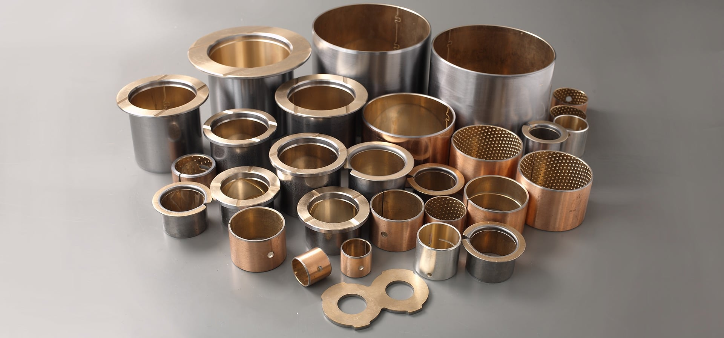






About Menon Bearings
India’s Leading Bearing Manufacturer
with Zero PPM Defects
Introducing a New Product Line :
Bi-Metal Products
Alkop
Brakes
3 Plants in Kolhapur
1 Office & Warehouse in Indianapolis, USA
Asbestos-Free
Brake Lining
Brake Shoes
4
Bearings
Bushes
Thrust Washers
Aluminum Die-Cast Products
Strong Brand Equity and Network
Strongly positioned globally with exports to over 24 countries
Fully integrated manufacturing facilities under one roof
Revenue Mix (FY23)
Bi-Metal Products : 73%
Aluminum (Alkop) : 27%
73:27
Catering to Light & Heavy Commercial Vehicle
Engines, Industrial & Tractor Engines, Compressors for
Refrigerators, Pumps, Braking Systems, Axles etc.
Market Leader in the bearings segment and a dominant source for top auto OEMs across the world
Manufacturers of highly critical moving engine components that operate in high temperature & pressure, inside engines with high payloads
30% Export Revenue (FY23)
Major Countries:
USA, Brazil, Mexico, Netherlands, Africa, Japan
30%

Slide 18



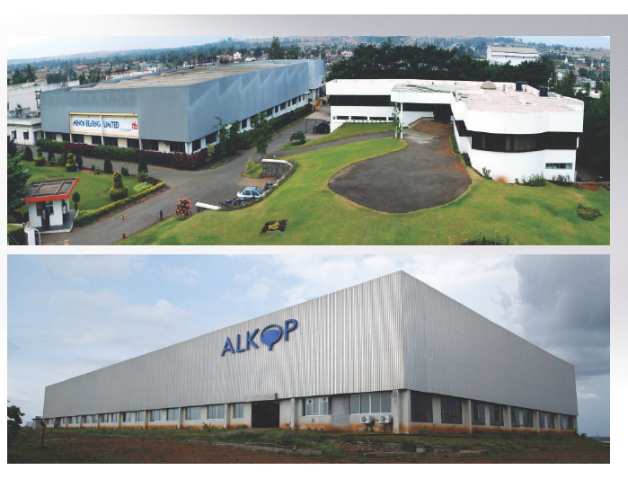
State of the Art Manufacturing Facilities
In-House
Design &
Development Facilities
Strategically located manufacturing facilities in Kolhapur, Maharashtra, spread over an area of 26+ acres
Warehouse & an Office in
Indianapolis, USA.
Among the few companies to have facilities to produce next generation parts through lead-free material to ensure the future emission norms.
Alloy Powder Manufacturing
Strip
Manufacturing
Machining PTFE
Coating

Slide 19
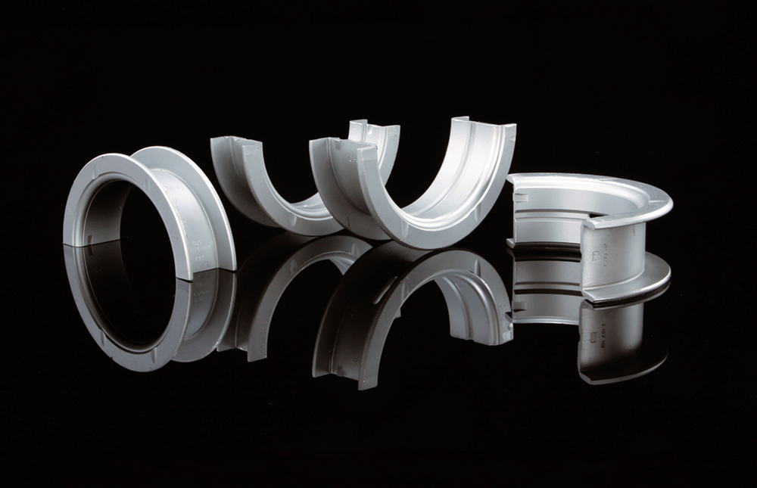
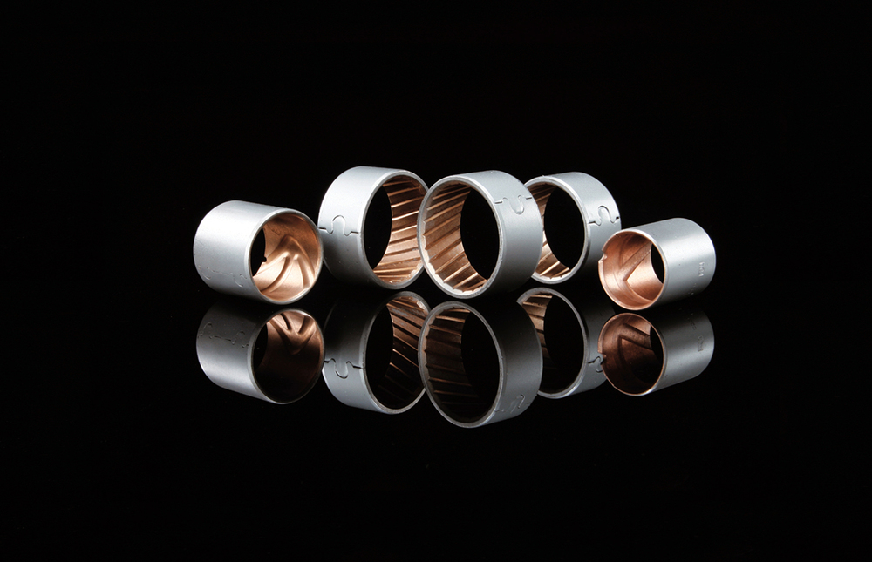
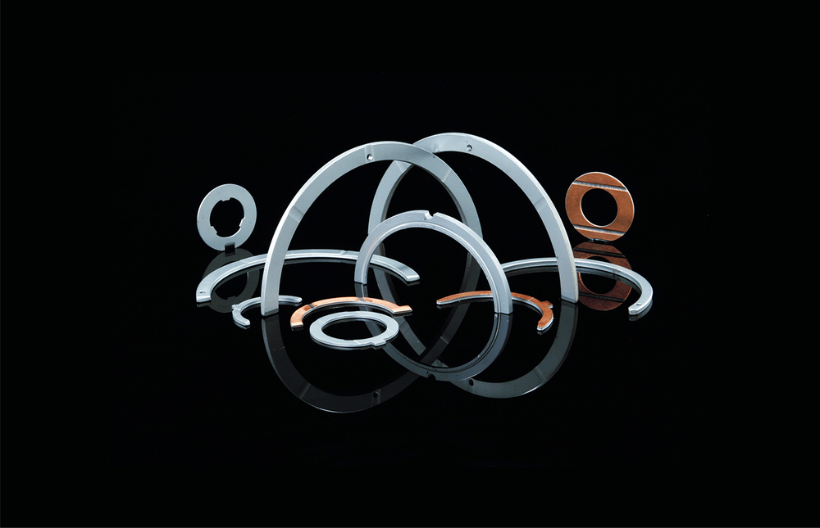
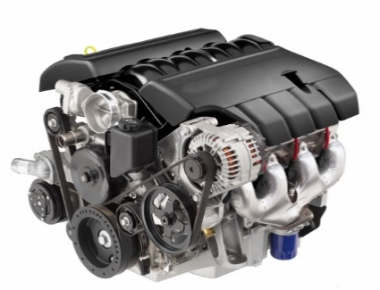
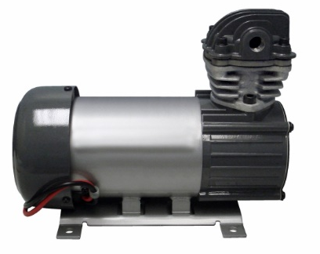
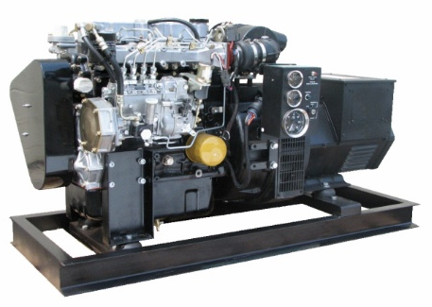
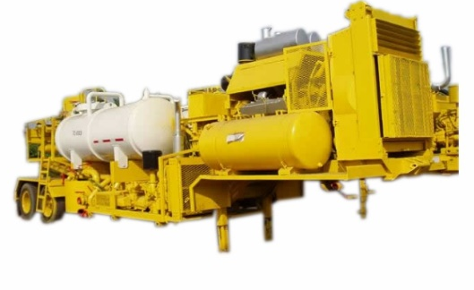
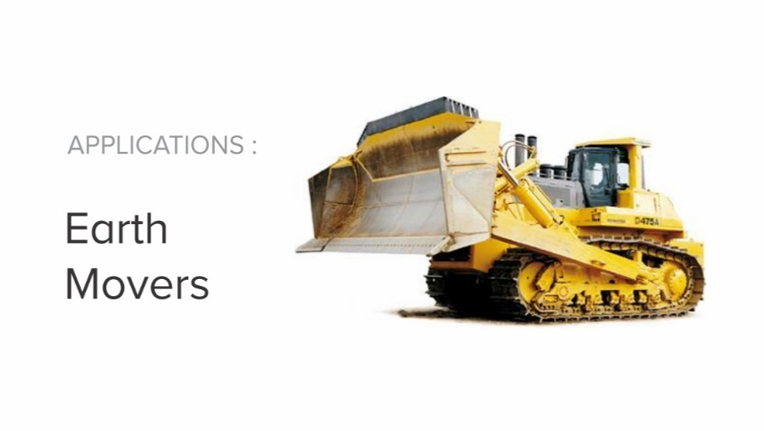
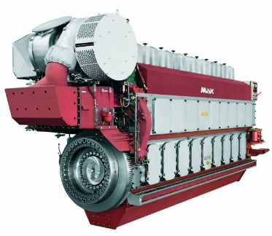
Diversified Products: Bi-Metal Products
Bearings
Bushes
Thrust Washers
Bearings for Connecting Rods
Bearings for Crank shafts
Flanged Bearings
Truncated Bushes for Connecting Rods
Ball Indented Bushes
Bushes for Connecting Rods
Cam Shafts
Rock Shafts
Rocker Arms
Washers with Thrust Face Contours
Ring Type Thrust Washers
30 to 175 mm dia
15 to 130 mm dia
40 to 225 mm dia
Applications
Automotive Engines
Compressors
Generators
Stationery Engines
Earth Movers
Marine Engines

Slide 20
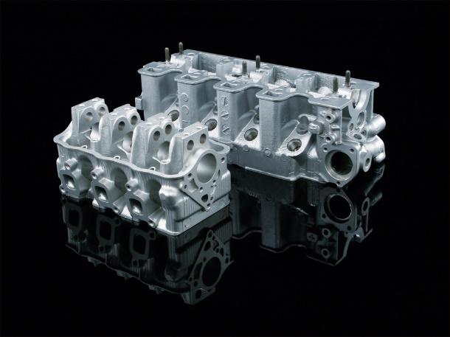
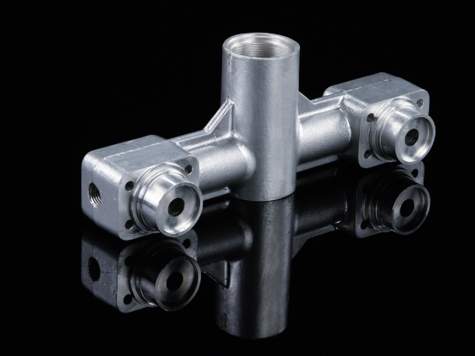
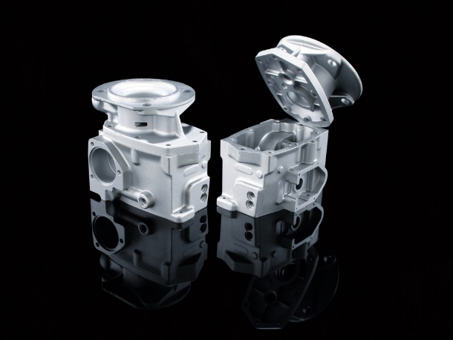
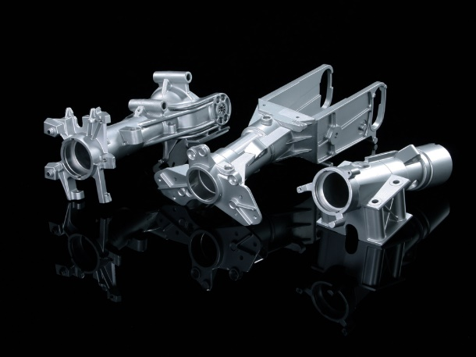
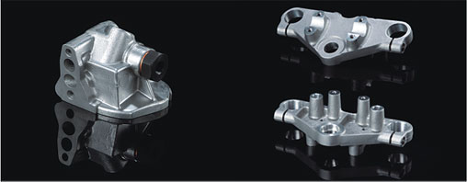
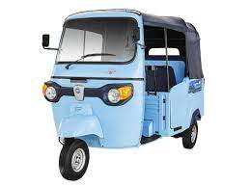
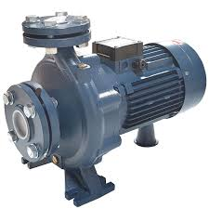
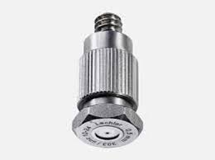
Diversified Products: Aluminum Die-Cast
Aluminum Products with wide range of applications
Up to
4.5 Kgs./Piece
High Pressure Aluminum Die Cast & Machined Component
Up to
15 Kgs./Piece
Gravity/ Tilt Gravity Aluminum Die Cast & Machined Components
Applications
Engines
Compressors
2W/3W
Oil & Gas
Pumps
Safety Equipment's

Slide 21
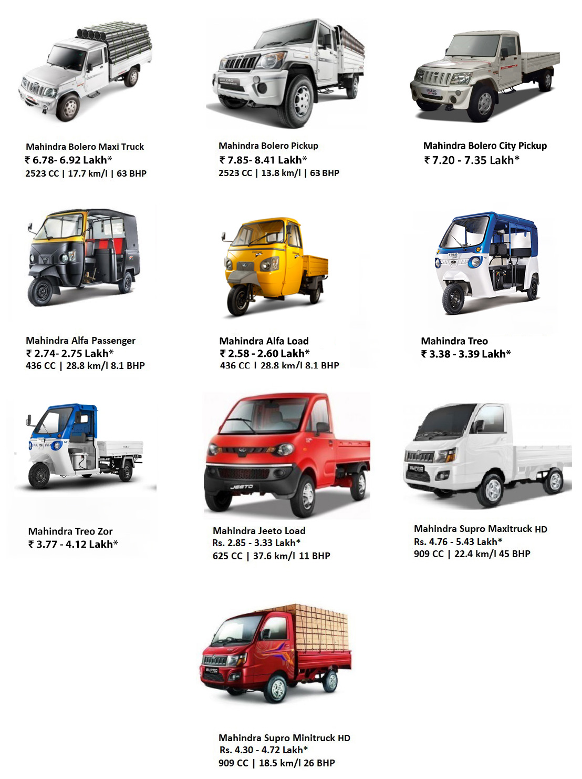
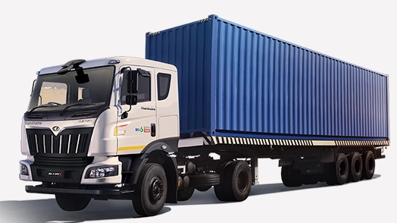
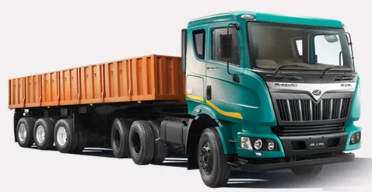
Diversified Products: Brakes
New Product Line in eco-antifriction (asbestos free) materials and products like Brake Lining, Brake Shoes
Eco-friendly brake friction materials are formulated without copper, lead, tin, antimony trisulfide to minimize their potential negative environmental impacts.
Asbestos is a naturally occurring mineral composed of flexible fibre that are resistant to heat, electricity and corrosion. These qualities make the mineral useful. However, asbestos exposure is highly toxic.
Professional automotive technicians and home mechanics who repair and replace brakes and clutches may be exposed to asbestos dust which can be cancer causing.
Non-Asbestos Organic (NAO) Brake Lining is made from organic materials like rubber, glass.
Applications in Commercial Vehicles (both Light & Heavy).
Applications
LCV
HCV

Slide 22
Current Capacities & Capex Plan
Bi-Metals Capacity (in lakhs)
Alkop Capacity (in MT)
+7%
0%
Planned a capex of ₹ 30 Cr till FY25 on Plant & Machinery of which
40%
for Bi-Metal Division to cater to increased market demand
60%
to be allocated to higher margin Alkop division
FY22
FY23
FY22
FY23
70% Capacity Utilizations
68% Capacity Utilizations
70% Capacity Utilizations
70% Capacity Utilizations
Increase in bi-metals capacity as we have put up new lines to cater to the surged demand

Slide 23
In-House Engineering & Development
In house Machine
Building Capability
In-House Tool Room
for faster Development
21 BFC Machines
(16 - 400 MT Capacity)
200+ Special Purpose
Machines
Dedicated team of Experienced Engineers having expertise in various engineering applications & problem-solving skills to provide total Engineering Solutions to our customers
Engineering Department to Design SPM, Tooling, Gauges & Fixtures using Solid Works & Auto CAD which ensures First Time Right Samples & minimum development time
In-house Tool Room consist of Turning m/c, Boring m/c, Bench Grinders, Center less Grinders etc. for faster and precise tooling development
Significant savings in Cost due to in-house development of machines & tooling capabilities offer us competitive advantage over peers

Slide 24
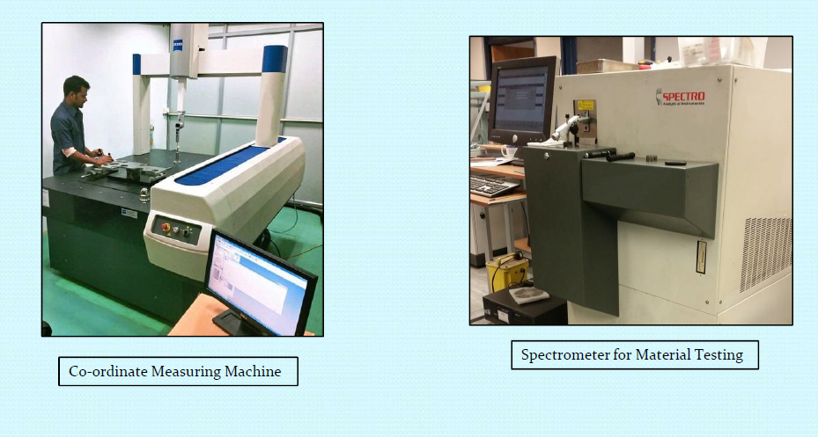

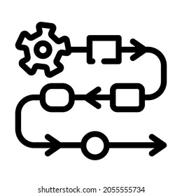


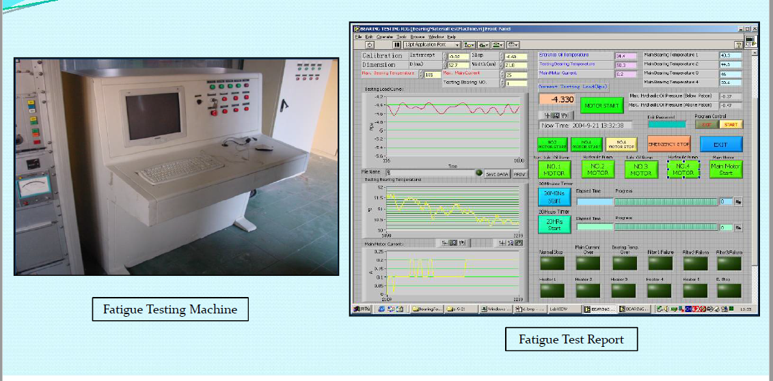
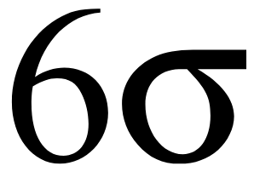
Quality Assurance
Quality at MBL is an online & continuous activity integrating people, communication, process controls, designing, engineering, production & inspection departments
Online & Continuous Activity
Begins with an attitude we inculcate via comprehensive & continuous training to all our personnel. Quality flows from our people through our processes to our product.
Co-ordinate Measuring Machine
Comprehensive & Continuous Training
Rigorously documentation of Quality Systems & Procedures is implemented & executed by a team using sophisticated equipment's in inspection & testing technology calibrated to world standards.
Inspection & Testing Technology
Spectrometer for Material Testing
Our high-tech Tooling Department is equipped with sophisticated ultra precision machines which help in maintaining speedy & high quality of Tooling
Speedy & High Quality of Tooling
Data driven continuous quality improvement systems are implemented by means of Lean/Six Sigma Tools
Lean/Six Sigma Tools
Fatigue Testing Machine

Slide 25
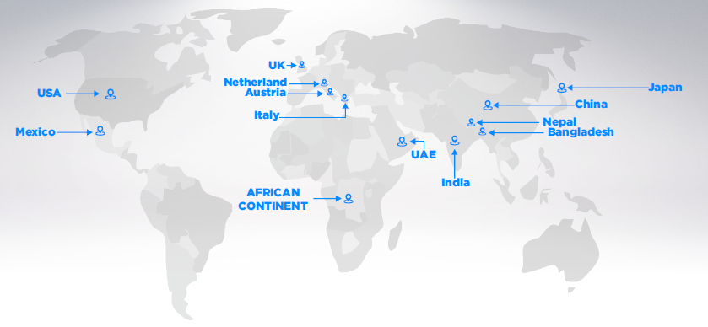
Diversified Industry Application with growing Exports
Exporting to 24+ Countries &
plans to reach Africa & Latin America through large distributor network
Revenue from Exports (Rs. in Crs)
+12%
Our office & warehouse in Indianapolis, USA has been helping to serve customers in & around the region since the 2 Decades
FY21
FY22
FY23
Export Contribution
FY22
FY23
Domestic
Exports
Maps not to scale. All data, information, and maps are provided "as is" without warranty or any representation of accuracy, timeliness or completeness.

Slide 26
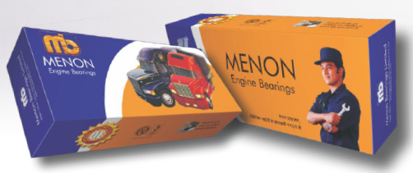



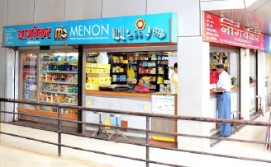

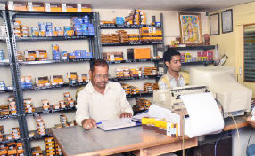


Formidable Reach & Brand Equity in the After-Market
Products present at
10,000+
retail outlets across India
Retail field relationships build & nurtured for
over 2 decades
Robust network of
1,000
dealers & distributors
Strong marketing team of 40 executives across India
trained to provide technical support services to mechanics
Our aftersales network serves a national community of 30,000+
mechanics & reborers

Slide 27





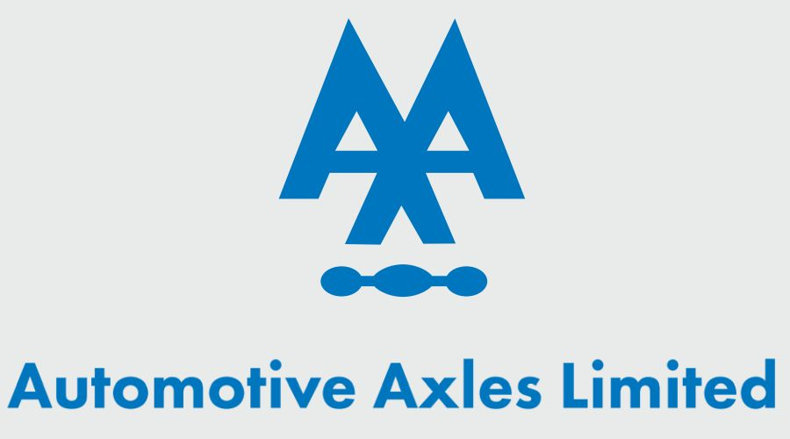

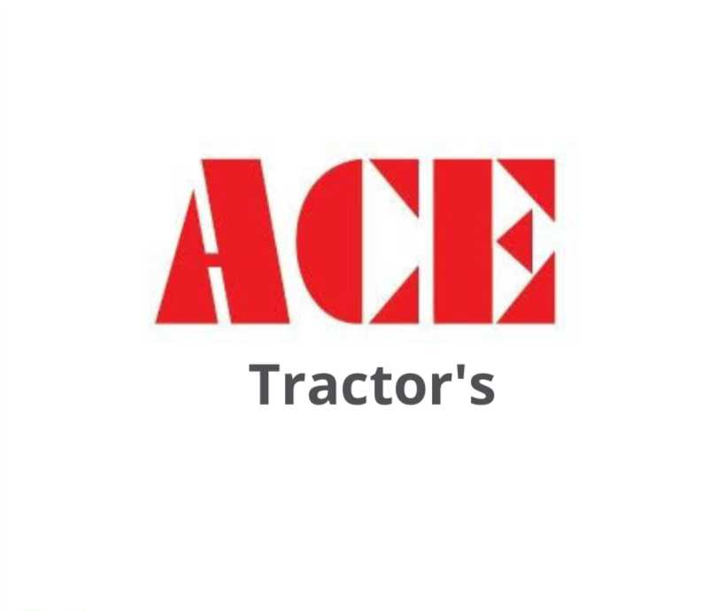





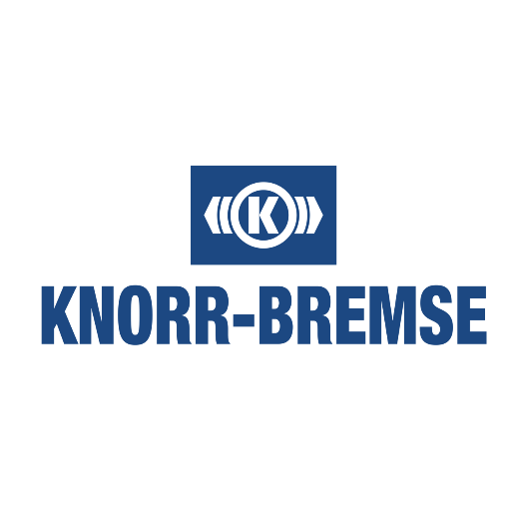

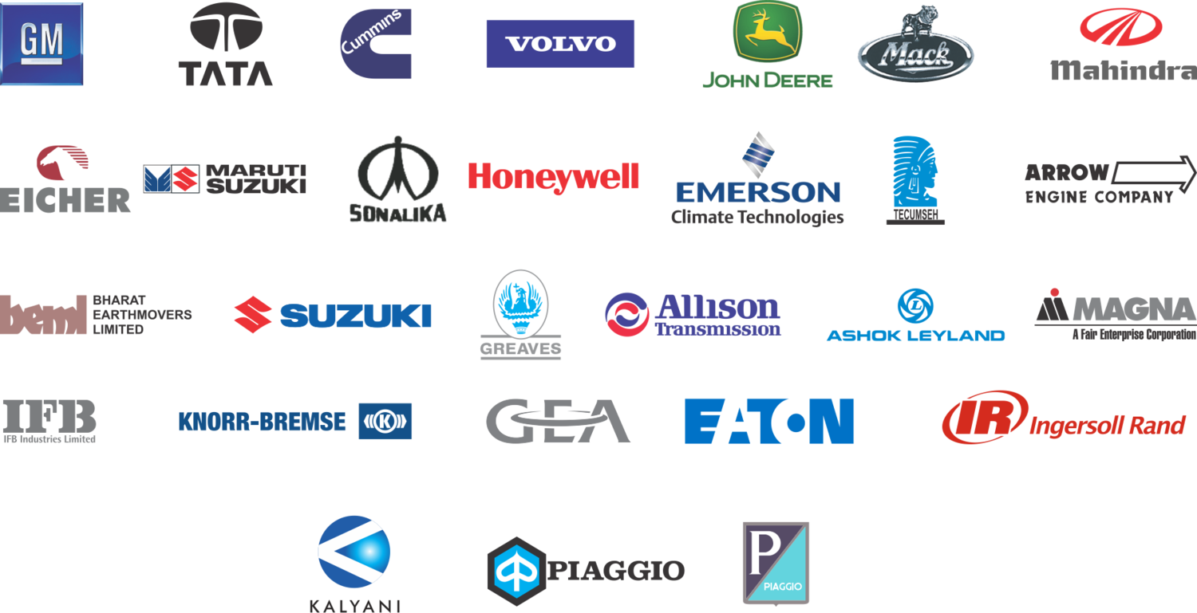




Diversified Marquee Clientele across Industries
Industry diversified revenue thereby reducing dependency on any Industry
Engine & Commercial
Vehicle (HCVs & LCVs)
Tractors
Electrical & Industrial Applications
Exports
No single customer contributes more than 10-12% of business
The Brand Names mentioned are the property of their respective owners and are used here for identification purposes only

Slide 28

Customer Recognitions, Awards & Accolades

Slide 29
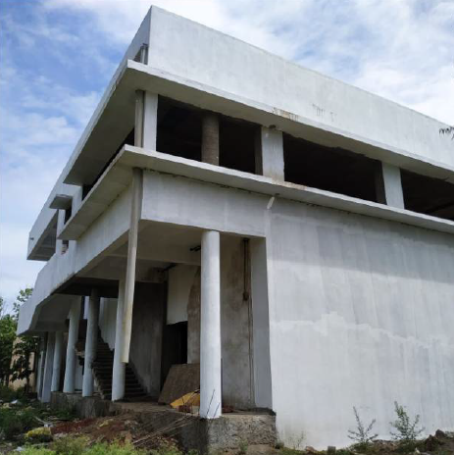

CSR & ESG Initiatives
Constructed an Auditorium at Gokul Shirgaon MIDC
For promoting education & employment and enhancing vocational skills among children, working professionals & women
C
S
R
Financial Assistance provided
For promotion of rural sports & development of traditional arts & crafts
For COVID Relief:
Distributed masks, medicines and sanitizers to public
Donated a Multipurpose ICU Ventilator to Government Hospital
E
S
G
Menon Bearings is among the very few companies to have facilities to produce next generation
LEAD FREE materials to cater to Future Emission Norms

Slide 30




Industry Growth Drivers
Uptrend in per-capita income and breach of $2,450 level by FY23 will trigger auto demand
Middle class segment to constitute ~62% of India’s population by FY25 and drive consumption
Inclement factors driving demand and providing growth tailwinds
India cementing its position as a global automotive R&D hub, with many MNC’s setting manufacturing and R&D base
Ample availability of a low-cost and skilled workforce
Automobile sector to attract USD 8-10 bn in local and foreign investments by 2023
Investment in manufacturing to expand auto industry
Indigenization levels for most major domestic and foreign OEMs have been on the rise
Premiumization in demand is spawning domestic ancillary base
Explosive demand in entry level segment also giving impetus to cost effective manufacturing
Domestic demand and indigenization by MNC’s to drive demand
PLI schemes in auto and auto-component sector with financial outlay of INR 57,042 Crores under Atmanirbhar Bharat 3.0
GOI plans to spend $1.4 trillion on infrastructure by 2025, which will boost the demand for CVs and construction equipment
GOI’s vehicle scrappage policy is further expected to boost replacement demand
Policy initiatives to drive manufacturing

Slide 31
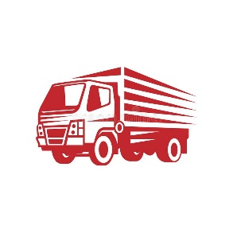
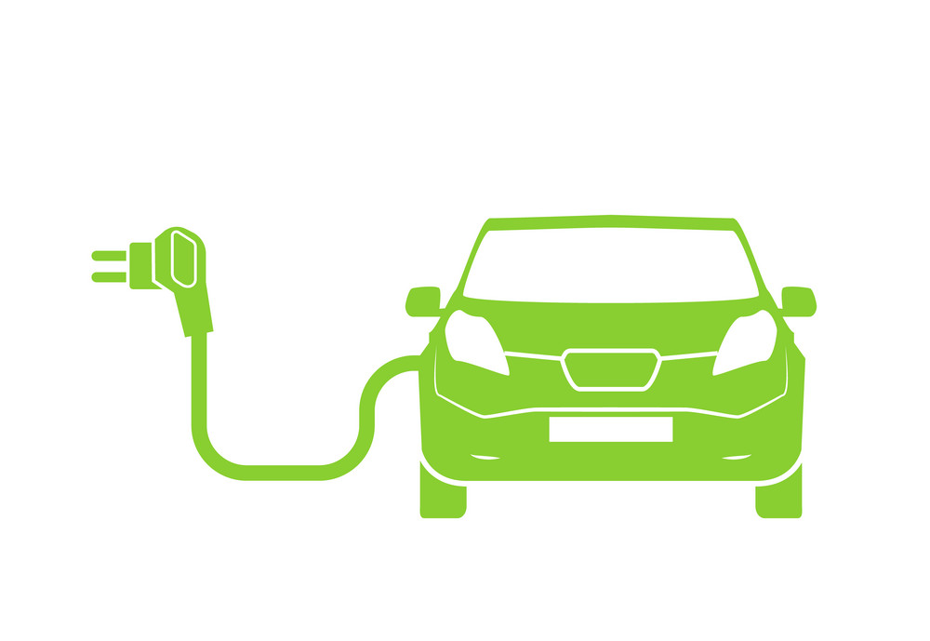

EV SHIFT – FAR FROM A RISK
Catering to
Industries & Applications
which will have low impact from change in shift to
Electric Vehicles
HCV & Industrial
We cater to heavy segments like Mines, Tractors, LCV/HCV etc. which are less challenged from the EV Segment
Long standing Relationship
We enjoy strong brand partnership with potential EV players to cater in Future

Slide 32
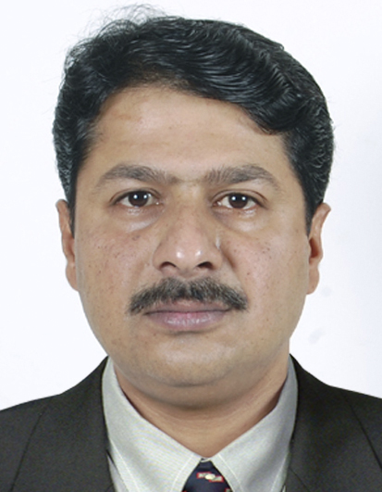
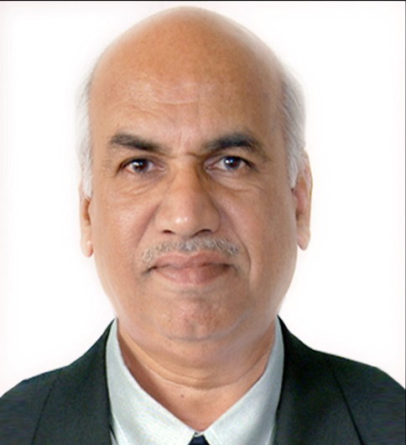
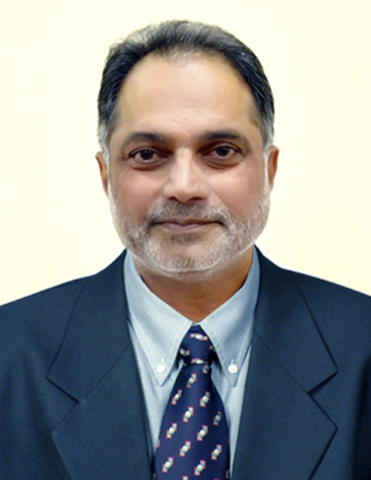
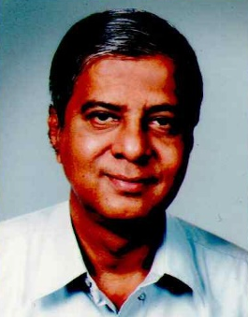
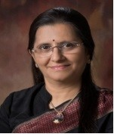
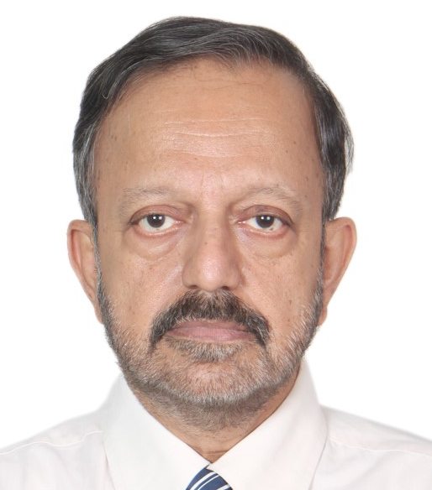
Experienced Board of Directors
Nitin Menon
R. D. Dixit
Arun Aradhye
Executive Chairman
Managing Director
Whole Time Director & CFO
Mr. Nitin Menon is an industrialist and has rich and varied experience in Automobile Sector. Associated with the Company since inception and lead the setup of 3 operational plants at Kolhapur
Mr. Dixit has worked with the Menon Group for more than 54 years and is engaged in day-to-day activities of the company and is responsible for overall management of the company. He is a B.E. (Mechanical)
Mr. Aradhye is associated with the company for more than 11 years. He is responsible for finance, corporate administration, corporate image and relationships. He has a vast experience of more than 41 years in fields like Engineering, Auto, Manufacturing, Industry etc
M. L. Shinde
Kailash A. Nevagi
Dr. Santosh Prabhu
Independent Director
Independent Director
Independent Director
Mr. Mukund Laxman Rao Shinde has vast experience of more than 40 years in the fields of Finance, Accounts, Corporate Laws, Taxation, etc.
Kailash Nevagi leads a team of lawyers as a Partner & Director at Abhay Nevagi and Associates and has wide experience of more than 30 years
Mr. Santosh Prabhu is a renowned Neurological and Spinal Surgeon. He is a member of many international bodies like World Federation of Neurosurgeon

Slide 33
Key Takeaways
Higher gestation in product approval cycle among suppliers due to technical nature of the products
High Entry Barrier
Land parcel available for future growth expansion in newer products segments to capture market growth
No Capacity Constraint
We build our own Tools and Machines which gives us an edge to make competitive priced products
In-house Machine Building Capacity
Wide end User Industry
Wide product portfolio catering to multiple sector, thereby de-risking the cyclical nature of any industry
Capabilities of manufacturing wide range of products and entering into new supplementary products segments
Diversified Product Portfolio
Long Standing Relationship
Long standing relationships with customers with approvals in place

Slide 34
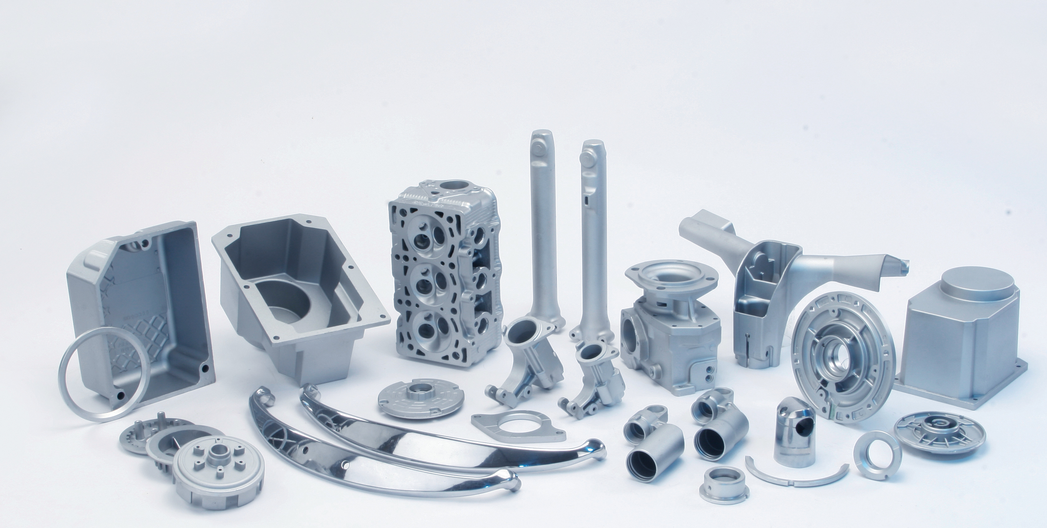

Menon Bearings Limited
CIN: L29130PN1991PLC062352
Mr. Arun Aradhye - Whole Time Director & CFO
admin@menonbearings.in
Thank You
Strategic Growth Advisors Private Limited
CIN: U74140MH2010PTC204285
Mr. Sagar Shroff / Mr. Vatsal Shah
sagar.shroff@sgapl.net / vatsal.shah@sgapl.net
+91 98205 19303 / +91 88796 59884

